Slide 1


Slide 2
Engineering Excellence – J1
Hadoop Cluster Setup
06: Sprint Review meeting : 07/01/2016
SPRINT 4 (June 20– July 01)

Slide 3
Last Week’s Action Items
All team members should attend weekly calls. In Progress
Team members to work in collaboration to achieve sprint goal. Done
Show only those user stories in product backlog that are to be given as deliverables. Extract the other user stories in separate section. Done
Plan demo for next week. Done

Slide 4
Last Week’s Action Items
Plan the work completion to resolve any dependency of items with you, if it is to be received by anyone else, before going to week long planned leave. Done

Slide 5
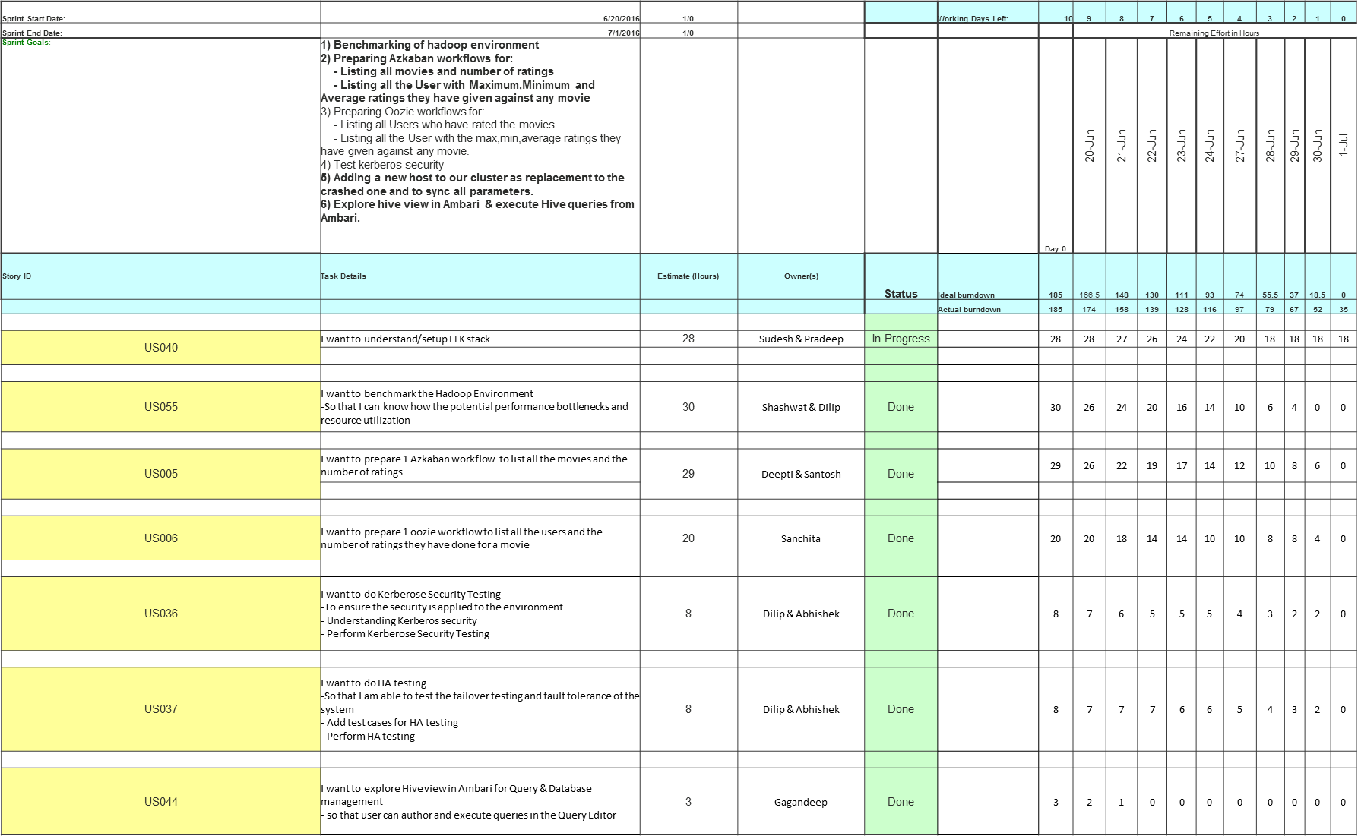
Team Status (Sprint 4)

Slide 6
Team Status (Sprint 4) Continued …
US013 | I want to prepare 1 Azkaban workflow to list all the User with : - Maximum ratings they have given against any movie - Minimum ratings they have given against any movie - Average ratings they have given against any movie | 12 | Gagandeep | Done |  | 12 | 12 | 12 | 11 | 11 | 10 | 8 | 6 | 4 | 2 | 0
US012 | I want to prepare 1 oozie workflow to list all the User with the max,min,average ratings they have given against any movie | 20 | Rupika | In- Progress |  | 20 | 20 | 18 | 18 | 16 | 16 | 16 | 16 | 16 | 16 | 16
US069 | Adding a new host to our cluster as replacement to the crashed one and to sync all parameters. | 4 | Sudesh | Done |  | 3 | 3 | 1 | 0 | 0 | 0 | 0 | 0 | 0 | 0 | 0
US014 | As a Dev I want to prepare 1 oozie workflow to list all the Movies with the max,min,average ratings given by any user So that I can list all the Movies with the max,min,average ratings given by any user. | 10 | OM | Done |  | 10 | 9 | 8 | 6 | 6 | 6 | 4 | 2 | 0 | 0 | 0
US010 | I want to prepare 1 oozie workflow to list all the Users who have rated the movies (Users who have rated atleast one movie) So that I can list all the Users who have rated the movies (Users who have rated atleast one movie). | 5 | OM | In- Progress |  | 5 | 5 | 5 | 5 | 5 | 5 | 4 | 3 | 2 | 1 | 1
US057 | I want to test Azkaban workflow which list all the movies and the number of ratings | 9 | Ravi | Done |  | 9 | 9 | 9 | 8 | 8 | 8 | 4 | 3 | 2 | 1 | 0

Slide 7
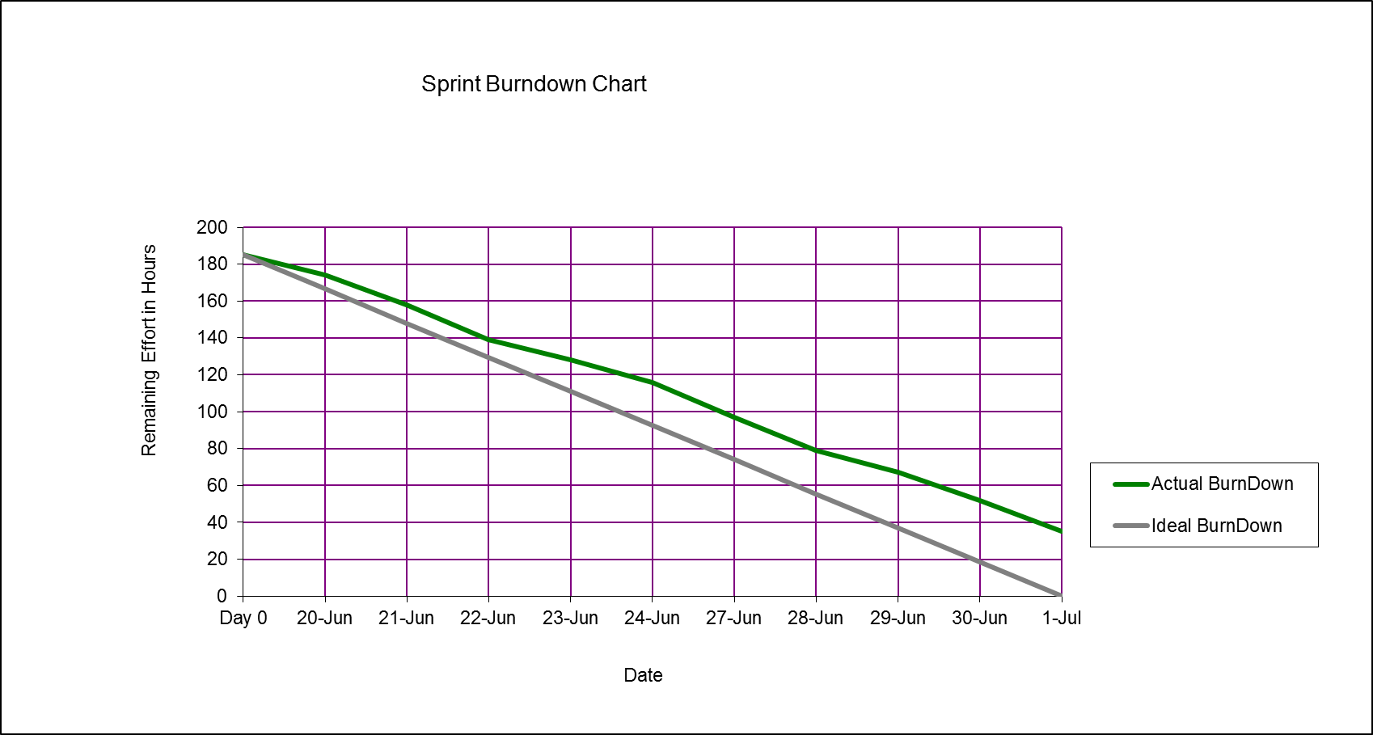
Burn down chart on – 07/01/2016

Slide 8
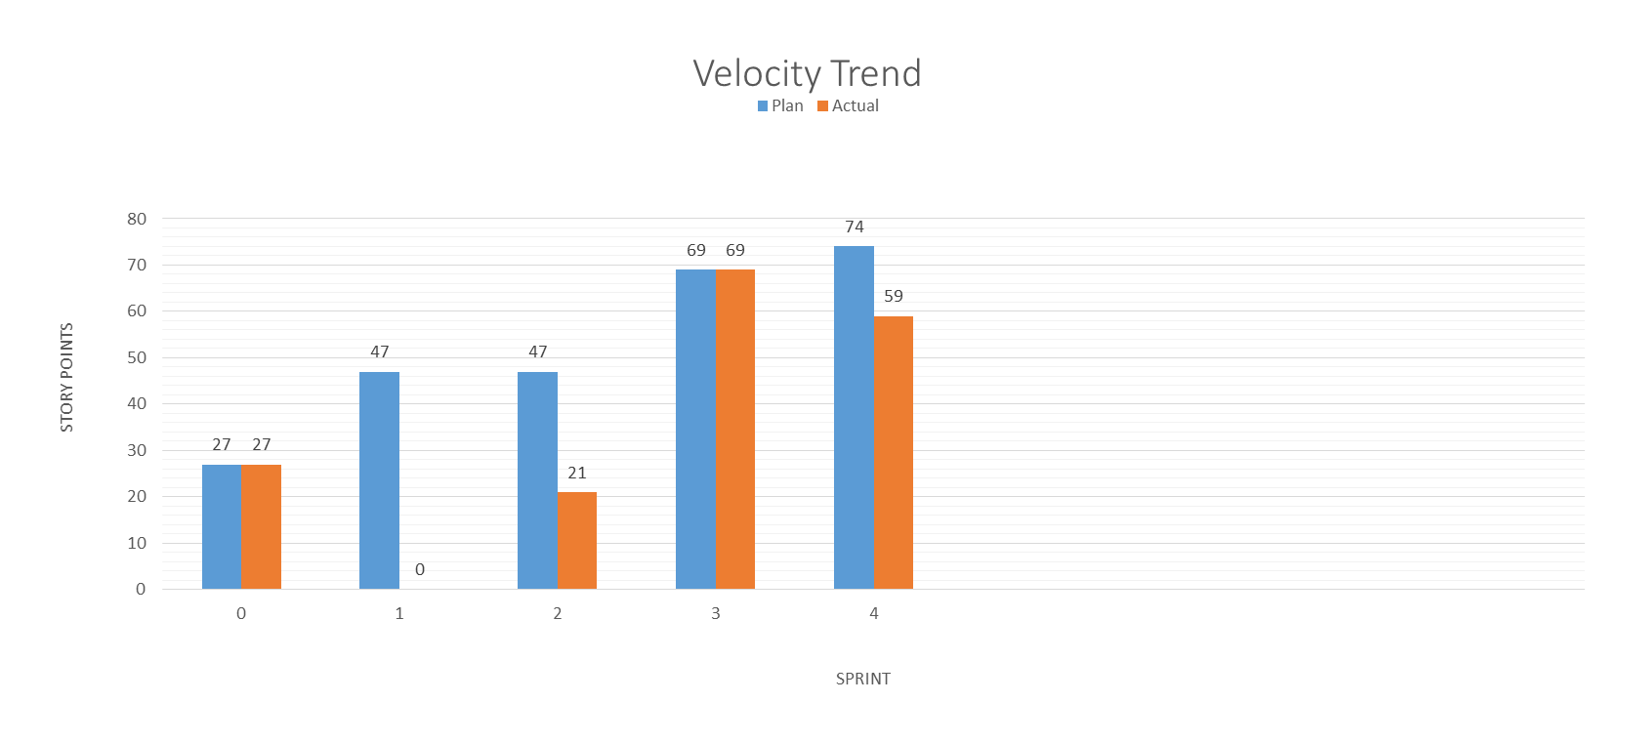
Velocity Trend on– 07/01/2016

Slide 9
Thanks

